Slide 1
Assignment3 / {Kernels}
Graphics Programming / Tristan Goodell

Slide 2
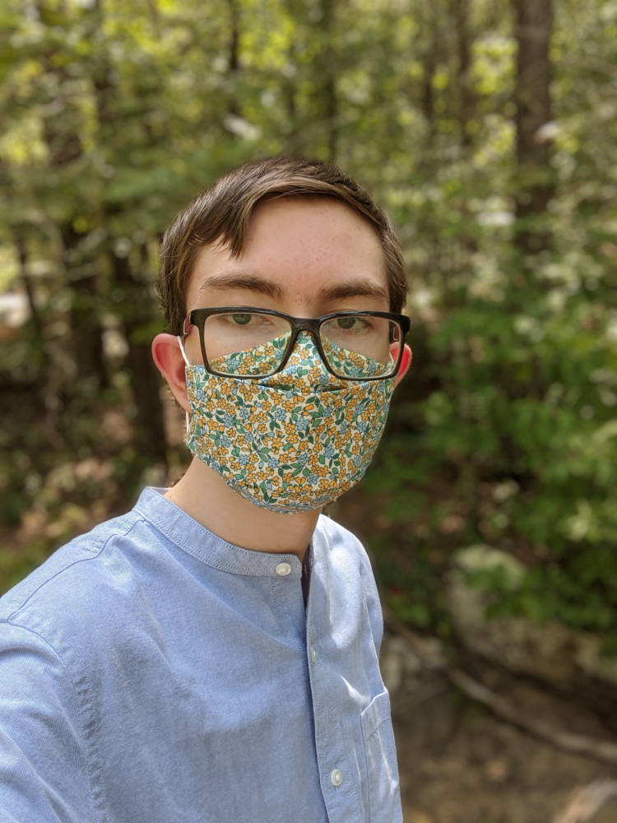




Box Blur / {pic_1_2_x}
Task: Develop a 3x3, 7x7, 1x7, and 1x3 Box Blur.
image1.png
Original
pic_1_2_1.png
3x3
pic_1_2_2.png
7x7
pic_1_2_3.png
1x7
pic_1_2_4.png
1x3

Slide 3
Box Blur / {kernels}
box3x3kernel=np.float64([[1/9,1/9,1/9], [1/9,1/9,1/9], [1/9,1/9,1/9]])
box7x7kernel=np.float64([[1/49,1/49,1/49,1/49,1/49,1/49,1/49], [1/49,1/49,1/49,1/49,1/49,1/49,1/49], [1/49,1/49,1/49,1/49,1/49,1/49,1/49], [1/49,1/49,1/49,1/49,1/49,1/49,1/49], [1/49,1/49,1/49,1/49,1/49,1/49,1/49], [1/49,1/49,1/49,1/49,1/49,1/49,1/49], [1/49,1/49,1/49,1/49,1/49,1/49,1/49]])
box1x7kernel=np.float64([[1/7,1/7,1/7,1/7,1/7,1/7,1/7]])
box1x3kernel=np.float64([[1/3,1/3,1/3]])

Slide 4



Box Edge Effects / {pic_1_3_x}
Task: Using the 7x7 kernel try out all edge effects.
image1.png
Original
pic_1_3_1.png
Reflect
pic_1_3_2.png
Constant
pic_1_3_3.png
Replicate
pic_1_3_4.png
Replicate101

Slide 5
Box Edge Effects / {code}
box7x7kernel=np.float64([[1/49,1/49,1/49,1/49,1/49,1/49,1/49], [1/49,1/49,1/49,1/49,1/49,1/49,1/49], [1/49,1/49,1/49,1/49,1/49,1/49,1/49], [1/49,1/49,1/49,1/49,1/49,1/49,1/49], [1/49,1/49,1/49,1/49,1/49,1/49,1/49], [1/49,1/49,1/49,1/49,1/49,1/49,1/49], [1/49,1/49,1/49,1/49,1/49,1/49,1/49]])
pic_1_3_1=normalize(cv2.filter2D(img,cv2.CV_64F,box7x7kernel,borderType=cv2.BORDER_REFLECT)) pic_1_3_2=normalize(cv2.filter2D(img,cv2.CV_64F,box7x7kernel,borderType=cv2.BORDER_CONSTANT)) pic_1_3_3=normalize(cv2.filter2D(img,cv2.CV_64F,box7x7kernel,borderType=cv2.BORDER_REPLICATE)) pic_1_3_4=normalize(cv2.filter2D(img,cv2.CV_64F,box7x7kernel,borderType=cv2.BORDER_REFLECT101))

Slide 6
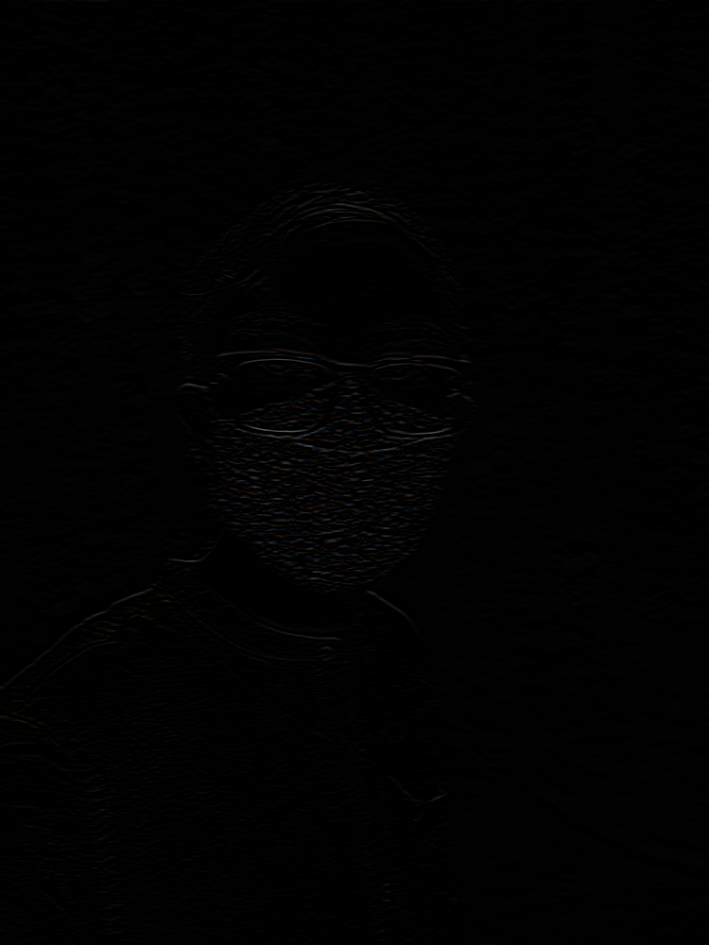
Box Edge Diff / {pic_1_4}
Task: Apply the 1x7 and its transposed. Do a diff with 7x7.
Diff Stats:
Max: 100
Min: 0
image1.png
Original
pic_1_4
Diff

Slide 7




Gaussian Blur / {pic_2_2_x}
Task: Develop a 3x3, 7x7, 1x7, and 1x3 Gaussian Blur.
image1.png
Original
pic_2_2_1.png
3x3
pic_2_2_2.png
7x7
pic_2_2_3.png
1x7
pic_2_2_4.png
1x3

Slide 8
Gaussian Blur / {kernels}
gauss3x3kernel=np.float64([[0.0625,0.125,0.0625], [0.125,0.25,0.125], [0.0625,0.125,0.0625]])
gauss7x7kernel=np.float64([[0.00097656,0.00341797,0.00683594,0.00878906,0.00683594,0.00341797,0.00097656], [0.00341797,0.01196289,0.02392578,0.03076172,0.02392578,0.01196289,0.00341797], [0.00683594,0.02392578,0.04785156,0.06152344,0.04785156,0.02392578,0.00683594], [0.00878906,0.03076172,0.06152344,0.07910156,0.06152344,0.03076172,0.00878906], [0.00683594,0.02392578,0.04785156,0.06152344,0.04785156,0.02392578,0.00683594], [0.00341797,0.01196289,0.02392578,0.03076172,0.02392578,0.01196289,0.00341797], [0.00097656,0.00341797,0.00683594,0.00878906,0.00683594,0.00341797,0.00097656]])
gauss1x7kernel=np.float64([[0.03125,0.109375,0.21875,0.28125,0.21875,0.109375,0.03125]])
gauss1x3kernel=np.float64([[0.25,0.5,0.25]])

Slide 9



Gauss Edge Effects / {pic_2_3_x}
Task: Using the 7x7 kernel try out all edge effects.
image1.png
Original
pic_2_3_1.png
Reflect
pic_2_3_2.png
Constant
pic_2_3_3.png
Replicate
pic_2_3_4.png
Replicate101

Slide 10
Gauss Edge Effects / {code}
gauss7x7kernel=np.float64([[0.00097656,0.00341797,0.00683594,0.00878906,0.00683594,0.00341797,0.00097656], [0.00341797,0.01196289,0.02392578,0.03076172,0.02392578,0.01196289,0.00341797], [0.00683594,0.02392578,0.04785156,0.06152344,0.04785156,0.02392578,0.00683594], [0.00878906,0.03076172,0.06152344,0.07910156,0.06152344,0.03076172,0.00878906], [0.00683594,0.02392578,0.04785156,0.06152344,0.04785156,0.02392578,0.00683594], [0.00341797,0.01196289,0.02392578,0.03076172,0.02392578,0.01196289,0.00341797], [0.00097656,0.00341797,0.00683594,0.00878906,0.00683594,0.00341797,0.00097656]])
pic_2_3_1=normalize(cv2.filter2D(img,cv2.CV_64F,gauss7x7kernel,borderType=cv2.BORDER_REFLECT)) pic_2_3_2=normalize(cv2.filter2D(img,cv2.CV_64F,gauss7x7kernel,borderType=cv2.BORDER_CONSTANT)) pic_2_3_3=normalize(cv2.filter2D(img,cv2.CV_64F,gauss7x7kernel,borderType=cv2.BORDER_REPLICATE)) pic_2_3_4=normalize(cv2.filter2D(img,cv2.CV_64F,gauss7x7kernel,borderType=cv2.BORDER_REFLECT101))

Slide 11
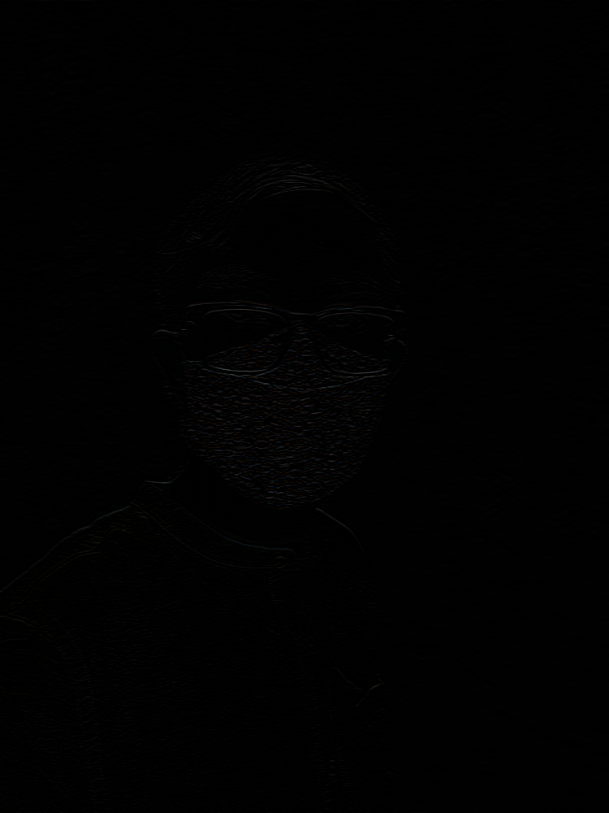
Gauss Edge Diff / {pic_2_4}
Task: Apply the 1x7 and its transposed. Do a diff with 7x7.
Diff Stats:
Max: 75
Min: 0
image1.png
Original
pic_2_4
Diff

Slide 12
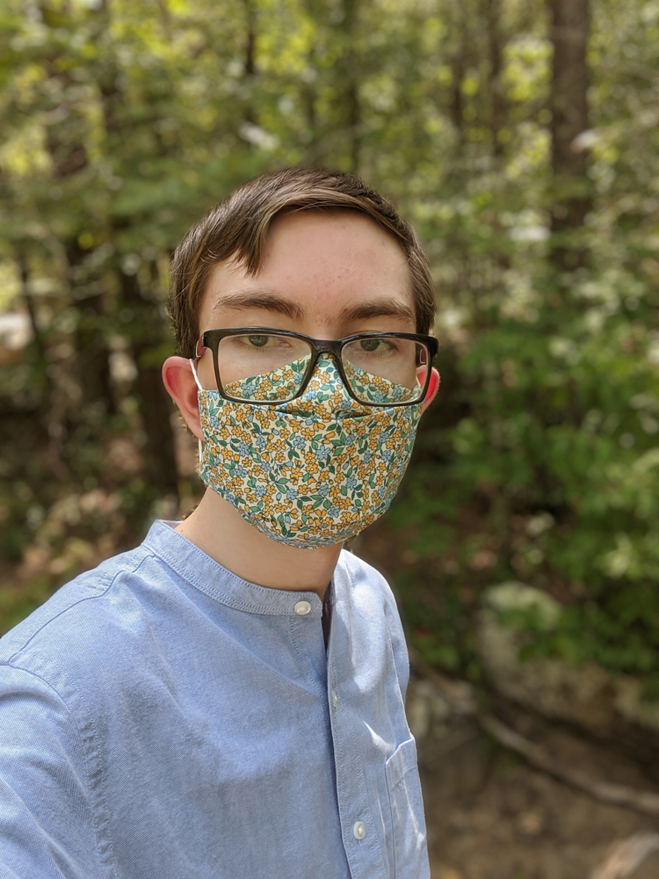



Sharpen / {pic_3_2_x}
Task: Make a 3x3, 5x5, 7x7, and 9x9 sharpen kernel.
image1.png
Original
pic_3_2_1.png
3x3
pic_3_2_2.png
5x5
pic_3_2_3.png
7x7
pic_3_2_4.png
9x9
Best Result

Slide 13
Sharpen / {kernels}
sharpen3x3kernel=np.float64([[0,-1,0], [-1,18,-1], [0,-1,0]]) sharpen5x5kernel=np.float64([[0,0,-1,0,0], [0,-1,-2,-1,0], [-1,-2,50,-2,-1], [0,-1,-2,-1,0], [0,0,-1,0,0]]) sharpen7x7kernel=np.float64([[0,0,-1,-2,-1,0,0], [0,-1,-2,-3,-2,-1,0], [-1,-2,-3,-4,-3,-2,-1], [-2,-3,-4,98,-4,-3,-2], [-1,-2,-3,-4,-3,-2,-1], [0,-1,-2,-3,-2,-1,0], [0,0,-1,-2,-1,0,0]]) sharpen9x9kernel=np.float64([[0,0,-1,-2,-3,-2,-1,0,0], [0,-1,-2,-3,-4,-3,-2,-1,0], [-1,-2,-3,-4,-5,-4,-3,-2,-1], [-2,-3,-4,-5,162,-5,-4,-3,-2], [-1,-2,-3,-4,-5,-4,-3,-2,-1], [0,-1,-2,-3,-4,-3,-2,-1,0], [0,0,-1,-2,-3,-2,-1,0,0]])

Slide 14
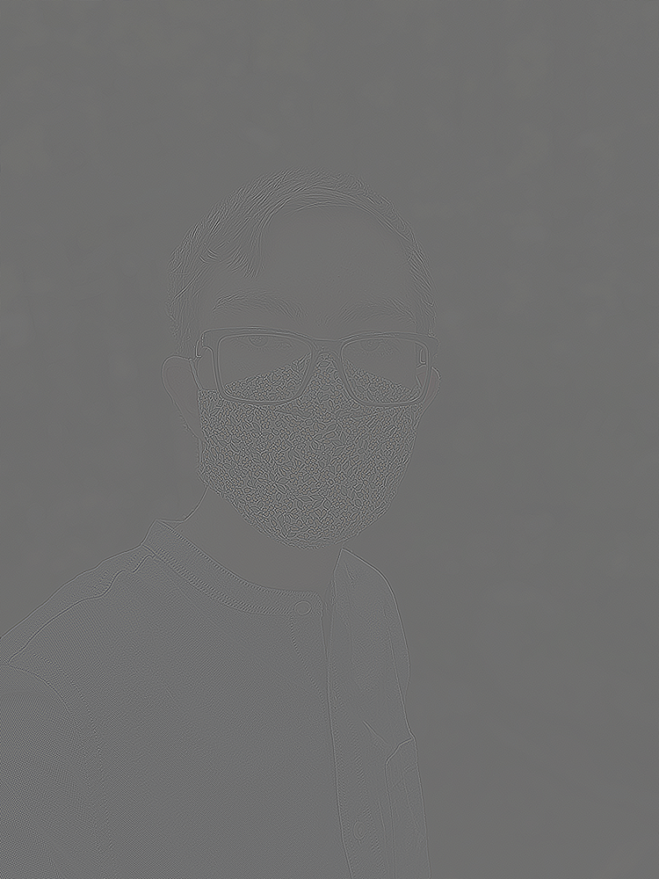
Sharpen 10
If we apply 5x5 Sharpen kernel ten times, we get:
image1.png
Original
superSharpen.png
5x5 Sharpen * 10

Slide 15
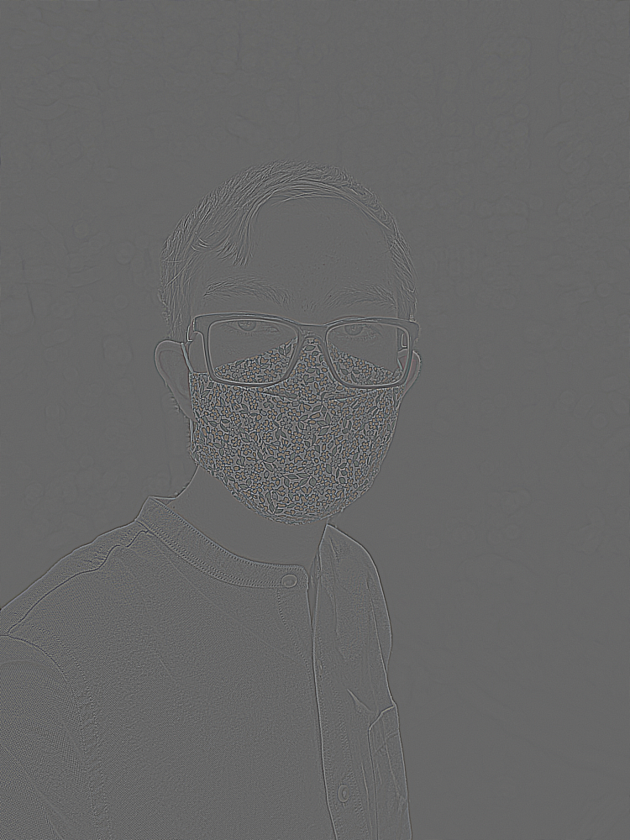
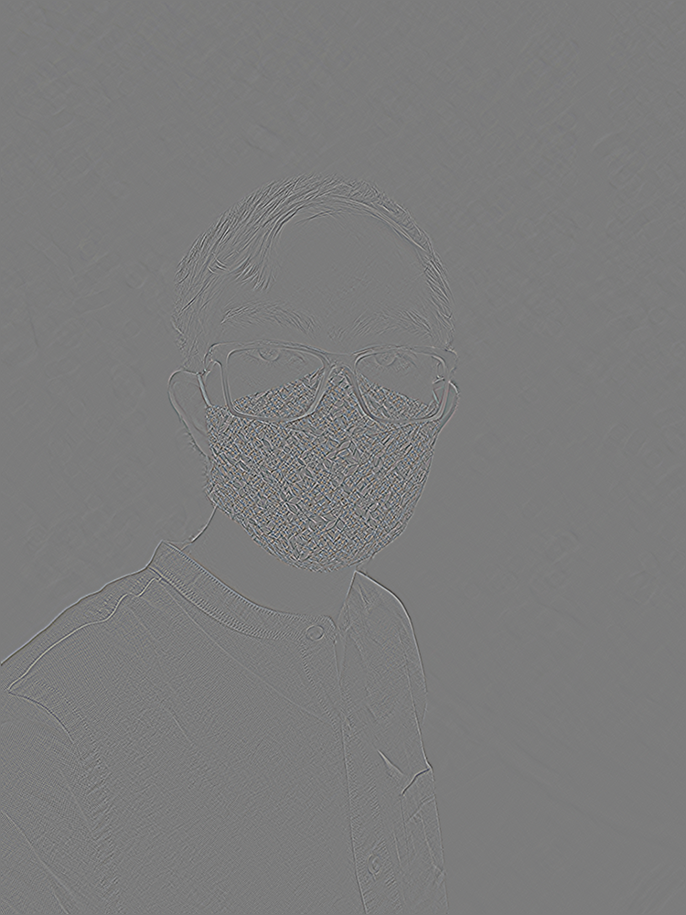
Edge Detection / {pic_4_x}
Task: Make an edge and a diagonal edge kernel to detect corners.
image1.png
Original
pic_4_1
Edge
pic_4_2
Diagonal

Slide 16
Edge Detection / {kernels}
edgeKernel=np.float64([[-1,-1,-1], [-1,8,-1], [-1,-1,-1]])
dedgeKernel=np.float64([[1,0,-1], [0,0,0], [-1,0,1]])

